Slide 1
An Accelerated Real-time Image Segmentation CNN Architecture for Pavement Crack
Yang Lu
April 5th , 2024

Slide 2
Background and Motivation
Methodology
Results
Notes:
Speak out all points

Slide 3
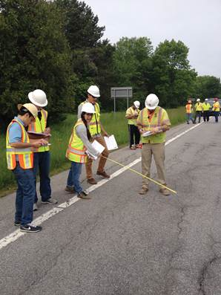
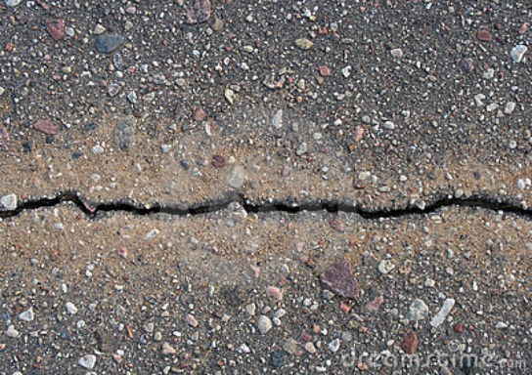

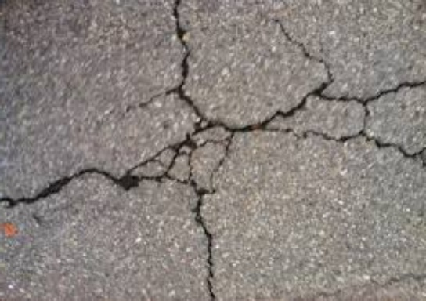
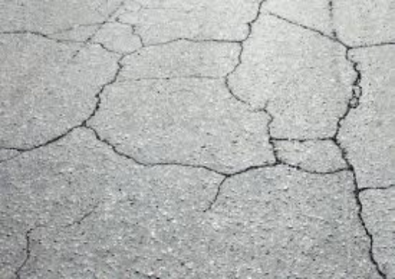
Background
Due to the extreme environments, the infrastructure of transportation, especially pavements, are easily broken and damaged.
The crack is one of the most severe defects.
Pavement Crack
Traditional inspection:
Time-consuming
Labor-intensive
Dangerous
Affect Traffic Flow
Seriously affects the service life of road
People’s comfortable when driving
Notes:
Speak out all points

Slide 4
Background
Intelligent pavement detection
and identification becomes a significant task.
Image processing
Machine learning
Deep learning

Slide 5
Motivation
The general trend of improving deep learning-based segmentation models is to include deeper layers and make more complicated structures in order to achieve higher accuracy. However, it will make the model become slower in training or predicting speed.
→ The increasing layers would dramatically increase the parameters in the model which would consume a lot of computing power during training and prediction.
In pavement crack detection practices, the segmentation tasks need to be carried out in a timely fashion on a computationally limited platform. A high-accuracy but computing-costly model is hard to perform well in a real-life mobile application.
→ Moreover, a higher detection speed is very significant in improving transportation safety

Slide 6
Data
A DeepCrack dataset was utilized in this work to test the performance of the CNN networks. The DeepCrack dataset is an open-source dataset published in GitHub (https://github.com/yhlleo/DeepCrack).
This dataset consists of 537 RGB crack images with manually annotated segmentations. The image has a resolution of 544 * 384 pixels.
The images are divided into two subsets:
300 images for training
237 images for testing
Training
Testing
300
237

Slide 7
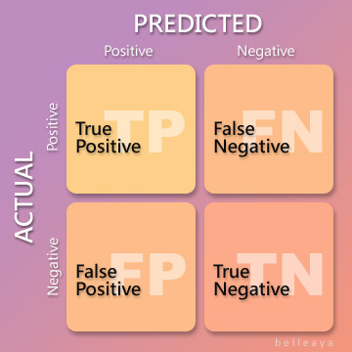
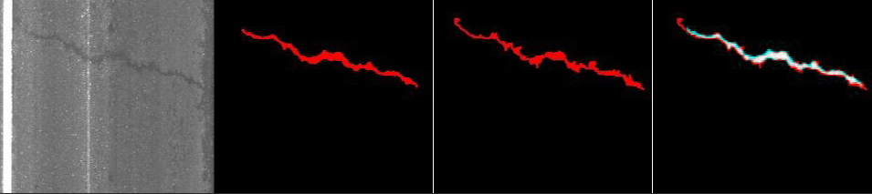
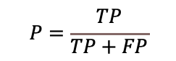
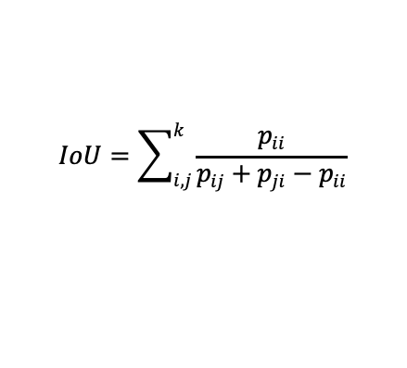
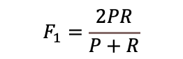
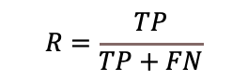
Evaluation metrics in Accuracy
$$P=\frac{TP}{TP+FP}$$
Precision (P) can measure how accurate the predictions are.
$$R=\frac{TP}{TP+FN}$$
Recall (R) suggests the level of sensitivity for prediction results.
$$F_{1}=\frac{2PR}{P+R}$$
F1 is defined based on the harmonic average of Precision and Recall.
From google images
The mIoU is the most important index showing the segment ability of the method as it counts and compares each pixel. A higher value in mIoU means more pixels is classified accurately.
$$IoU=\sum_{i,j}^{k}{\frac{p_{ii}}{p_{ij}+p_{ji}−p_{ii}}}$$
Raw image
Prediction
Ground Truth
IoU

Slide 8
Evaluation metrics in Efficiency
For the efficiency part, the training time of each model is measured to show how much computational resources the model needs in training.
The Frames Per Second (FPS) in the testing procedure is used to evaluate the efficiency of the models in predicting. The FPS can be an index for real-time jobs. A higher FPS indicates the model can process more images in a unit of time, which means it will have a better performance in real-time tasks.
The number of parameters is also calculated from each model as it is an important factor in a mobile device. A lightweight model can be easier to be deployed in a smart phone.

Slide 9
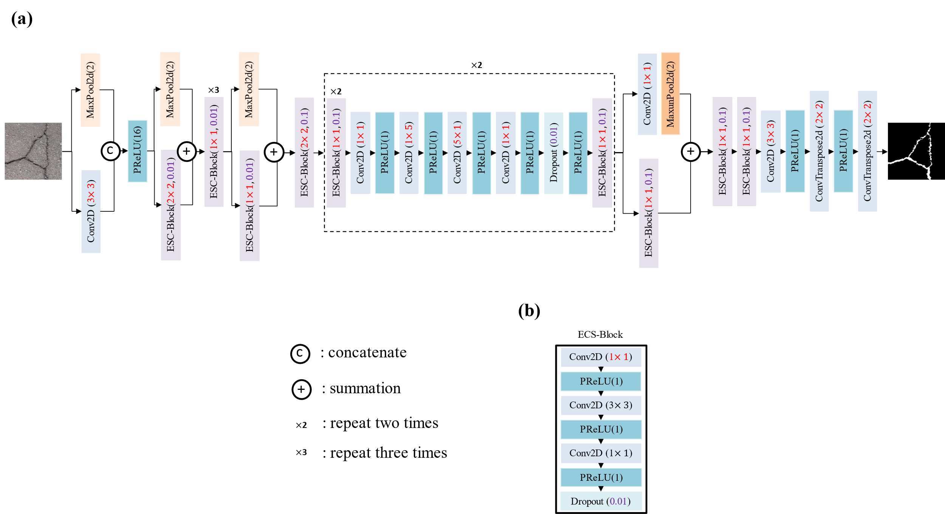
ECSNet structure

Slide 10
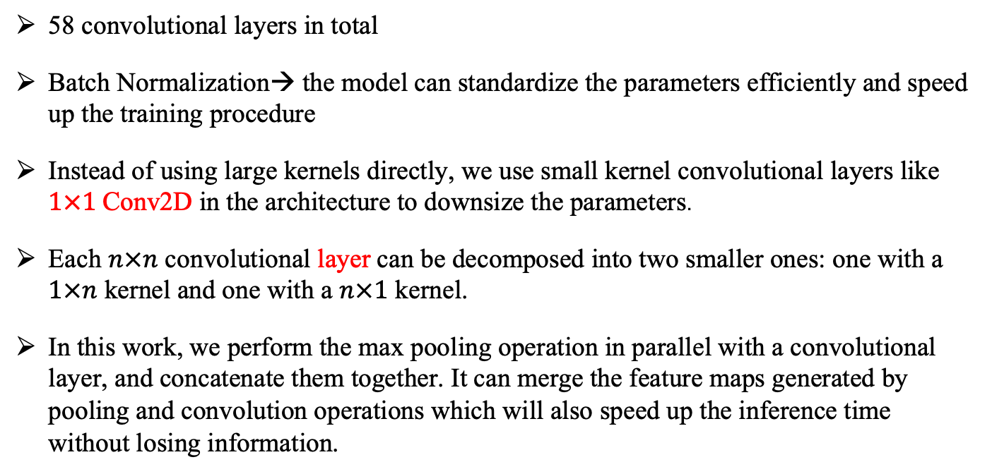
The improvements of ECSNet
58 convolutional layers in total
Batch Normalization→ the model can standardize the parameters efficiently and speed up the training procedure
Instead of using large kernels directly, we use small kernel convolutional layers like $1×1$Conv2D in the architecture to downsize the parameters.
Each $n×n$ convolutional layer can be decomposed into two smaller ones: one with a $1×n$ kernel and one with a $n×1$ kernel.
In this work, we perform the max pooling operation in parallel with a convolutional layer, and concatenate them together. It can merge the feature maps generated by pooling and convolution operations which will also speed up the inference time without losing information.

Slide 11
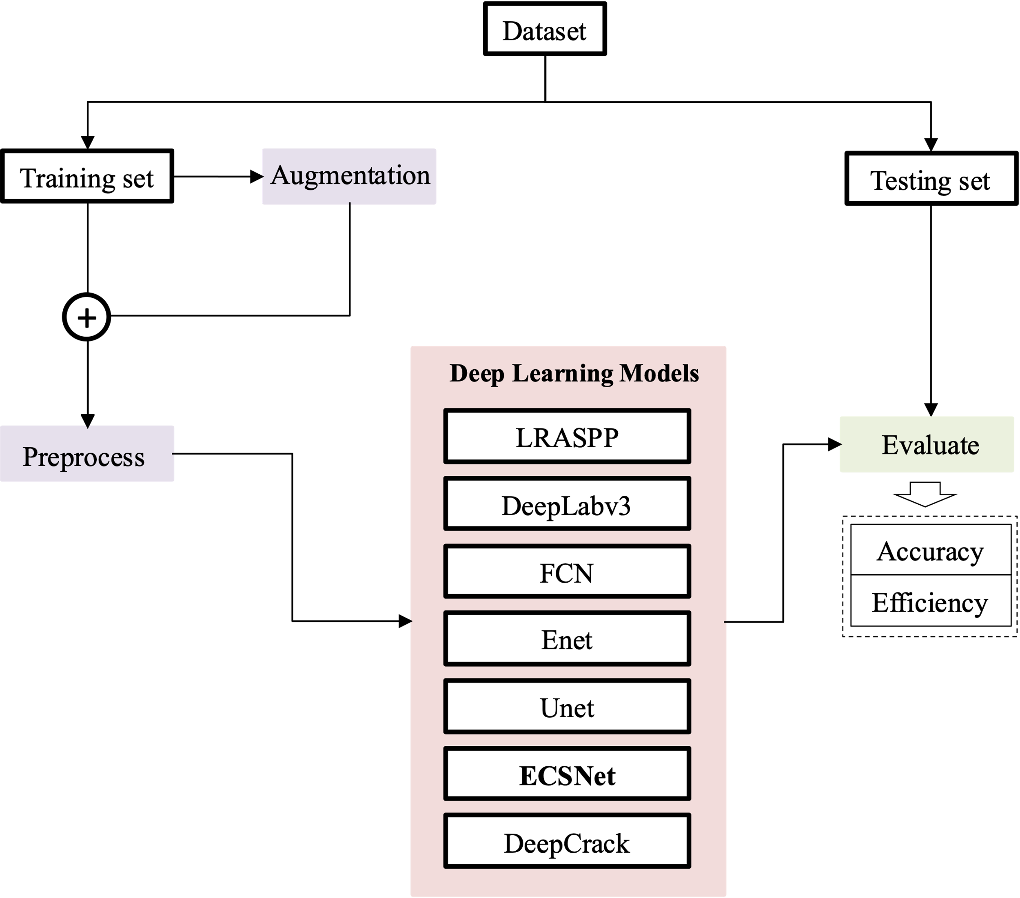
Validation process
Procedure to evaluate the capacity of ECSNet

Slide 12
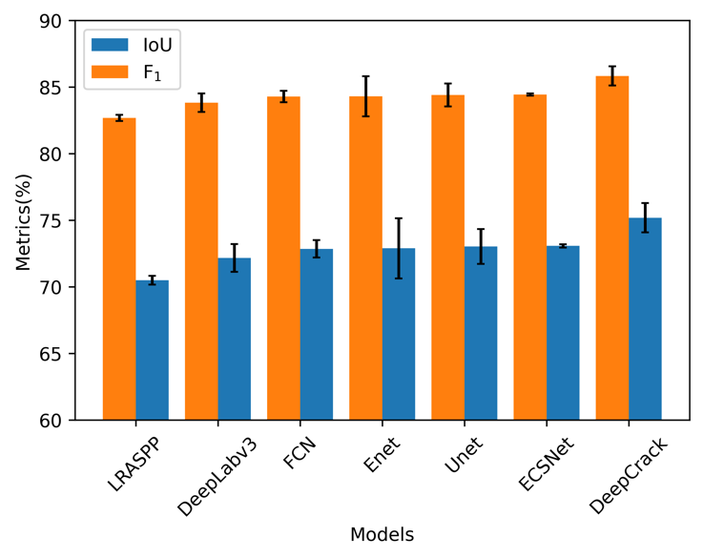
Accuracy evaluation
The F₁ score and IoU of all the tested models. The models are organized in ascending order based on the IoU values achieved on the DeepCrack dataset. The blue bar stands for the IoU and the orange bar stands for the F₁ score of each model. The black error bar is the standard deviation.

Slide 13
Accuracy evaluation
DeepCrack gets the highest F₁ score (85.84%) and IoU values (75.19%) among all the models.
ECSNet gains the second place in both F₁ score (84.45%) and IoU value (73.08%). The error bar of the testing results shows the standard deviation of each model.
ECSNet gets the lowest standard deviation among all the approaches. In other words, the performance of ECSNet is more stable and robust than other methods.

Slide 14
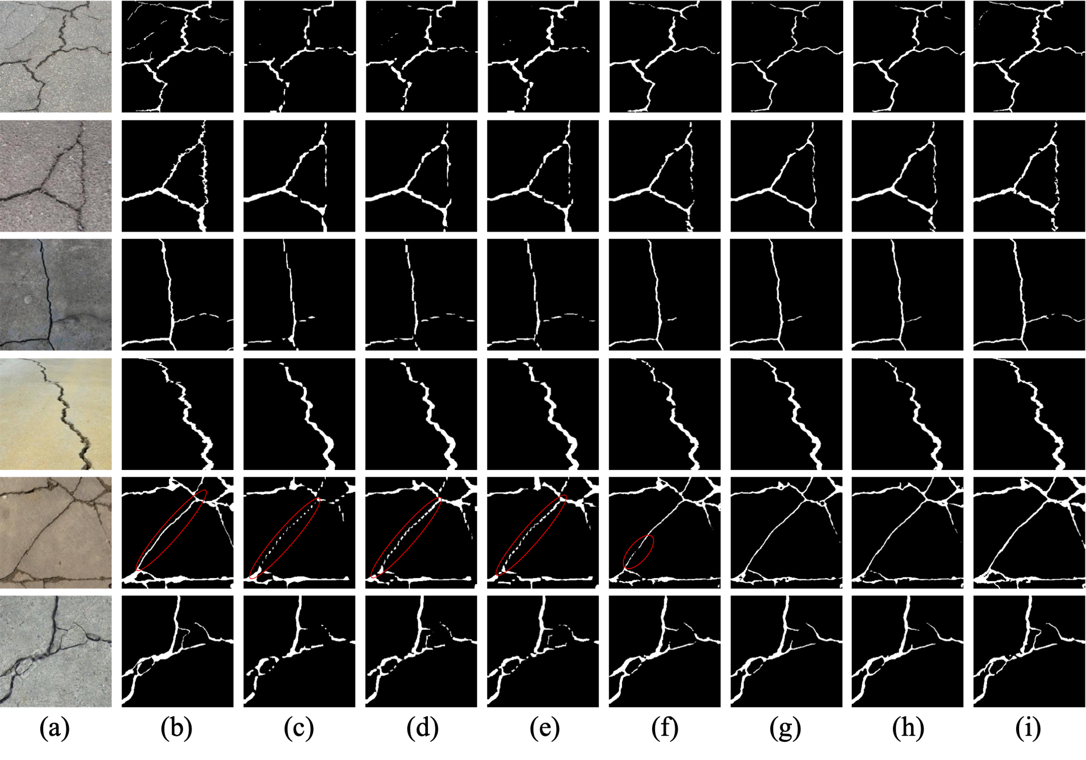
Accuracy evaluation
The visualization of detection results of different deep learning methods on the DeepCrack Dataset:
original image;
ground truth;
LRASPP;
DeepLabv3;
FCN;
Enet;
Unet;
ECSNet;
DeepCrack.
The red circle shows models including FCN, DeepLabv3 and LRASPP are intermittent in prediction compared to the ground truth.

Slide 15
Accuracy evaluation
the results from FCN, DeepLabv3 and LRASPP are intermittent compared to the ground truth especially in the red-circle part. The segmented images of DeepCrack, ECSNet and Unet are quite consistent with the ground truth compared to other models. It is noteworthy that the segmentation results from DeepCrack are the closest to the ground truth.

Slide 16
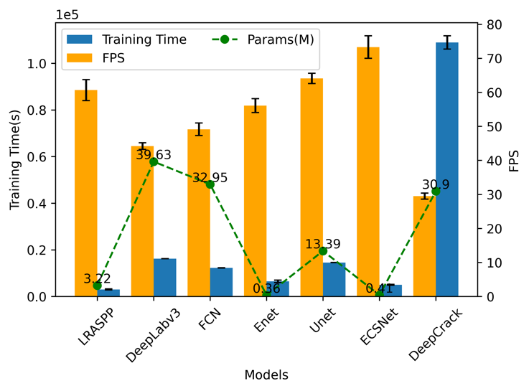
Efficiency evaluation
The efficiency-related performance of each model. The blue bar stands for the training time used by each model. The yellow bar is the FPS of each model performed on the DeepCrack dataset. The green points are the parameters contained in the models. The black error bar is the standard deviation.

Slide 17
Efficiency evaluation
training time each model spend is quite consistent with the FPS. In other words, a model’s structure complexity determines its efficiency, no matter in training or predicting. The DeepCrack consumes the highest time to train its parameters and also has the lowest FPS. The proposed ECSNet has the highest FPS among all the models which shows its high speed in pavement crack segmentation. It is about 2.5 times faster than the DeepCrack model.
There is no obvious linear relationship between the size of parameters and the efficiency. However, it is obvious that the lightweight models including Unet, Enet, LRASPP and ECSNet, need an averagely lower training time than the complex deep learning-based models (DeepCrack, DeepLabv3 and FCN). Moreover, the lightweight model has a higher FPS in predicting.

Slide 18
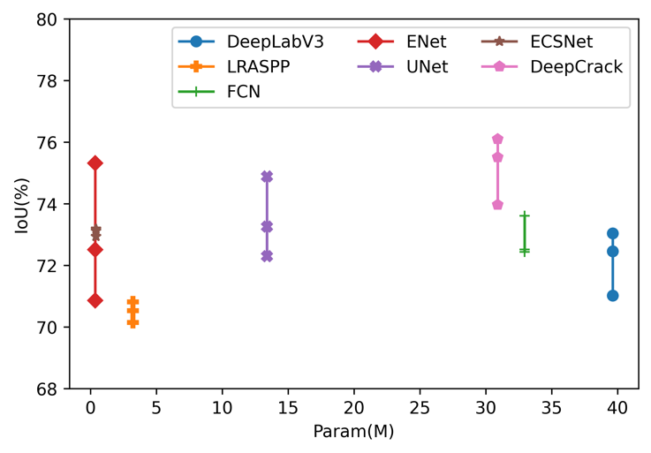
Relationship between the accuracy and efficiency
The relationship between IoU and the number of parameters in each model. Each point means a different test and there are three tests for each model.
The parameters contained in a model are an index to show its proper to be deployed in a mobile device. In other words, a lightweight model is more reasonable for mobile usage.
Enet and ECSNet have nearly the same parameter amount (0.36 M for Enet and 0.41 M for ECSNet), which is much smaller than other models. The average IoU value of Enet and ECSNet is 72.86% and 73.08%, respectively. The accuracy of ECSNet is a little higher than Enet. Furthermore, the standard deviation of IoU from Enet (2.26%) is much higher than ECSNet (0.12%). It means the performance from Enet is not stable enough like ECSNet.

Slide 19
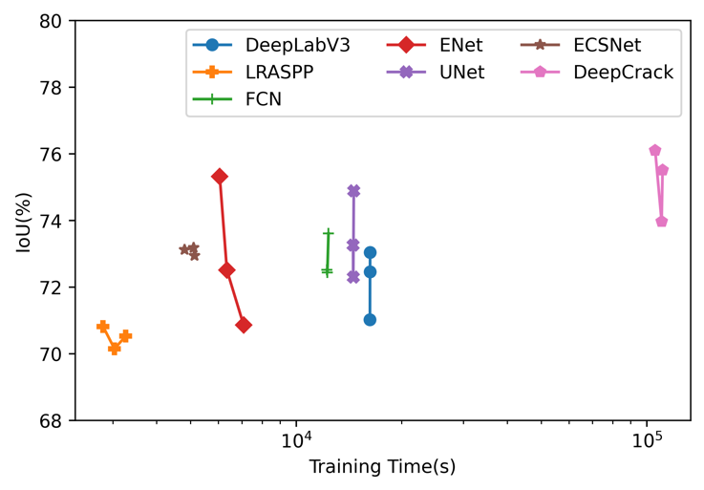
Relationship between the accuracy and efficiency
The relationship between IoU and Training Time of each model. Each point means a different test and there are three tests for each model.
The training time shows the model’s consumption on the computational source in order to train its parameters. It is an important factor as the model is always waiting to be updated with the increasing dataset. This is because updating the parameter can help improve the performance. The results show that the ECSNet only consumes about 5000 seconds to reach second place in the average IoU value. Compared with other segmentation algorithms, our proposal approach achieves a trade-off between the amount of training time and accuracy. The LRASPP uses the lowest time (about 2800 seconds) in the training procedure. However, the IoU metric is quite low (70.5%).

Slide 20
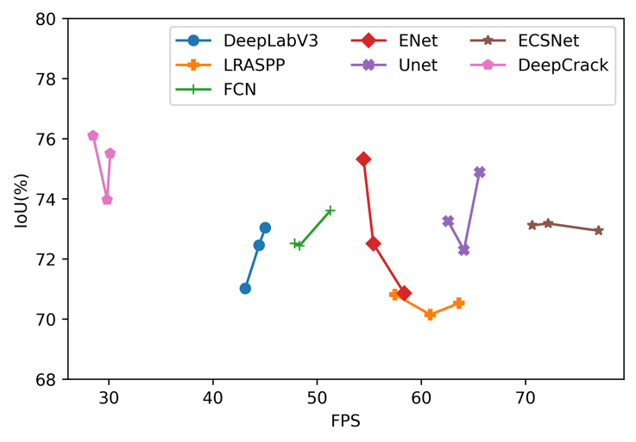
Relationship between the accuracy and efficiency
The relationship between IoU and FPS in each model. Each point means a different test and there are three tests for each model.
the proposed ECSNet gets an absolutely higher FPS (73.29) than any other models. The proposed method shows great potential in real-time applications as the FPS is an important index for pavement crack real-time detecting. However, it worth noticed that the IoU of ECSNet doesn’t drop when the network pays more attention to improving its performance on the information compression and detection speed. It only losses 2.8% of IoU compared to the model DeepCrack. However, the FPS of ECSNet is 2.5 times higher than DeepCrack (29.5). In other words, our designed network makes a trade-off between the model’s accuracy metrics and real-time requirements.

Slide 21
Conclusion
In this work, an ECSNet is proposed for real-time pavement crack detection tasks. It is designed as a lightweight real-time semantic segmentation model with high computational efficiency. An ECS-block consisting of 1×1 Conv2D, n×n Conv2D and 1×1 Conv2D is introduced to network as an alternative of a normal n×n Conv2D to reduce the model parameter and improve the computing speed. A parallel max pooling and convolutional operation are also introduced in the network to replace the sequence of convolution layer and max pooling layer, which speed up the downsizing and filtering process.
The proposed ECSNet is compared with other popular models, including DeepLabv3, LRASPP, FCN, Enet, Unet, and DeepCrack. According to the overall performance on the DeepCrack Dataset, the ECSNet obtains an F1 score of 84.45% and an IoU of 73.08%, which outperforms all the popular models except the model DeepCrack.
The segmentation result from ECSNet is clearer and more continuous than DeepLabv3, LRASPP and FCN. It is also demonstrated that the ECSNet has the highest FPS (73.29) and lowest training time (5011 seconds) among all trained models.
The ECSNet keeps a good balance between the accuracy and efficiency metrics. It only losses 2.8% of IoU to gain a 2.5 times higher FPS compared to DeepCrack model, which shows that ECSNet is a well-designed real-time image segmentation algorithm for the pavement crack detection task.

Slide 22
Thanks

